Slide 1


Bias Misperceived: The Role of Partisanship and Misinformation in YouTube Comment Moderation
Shan Jiang, Ronald Robertson, Christo Wilson

Slide 2
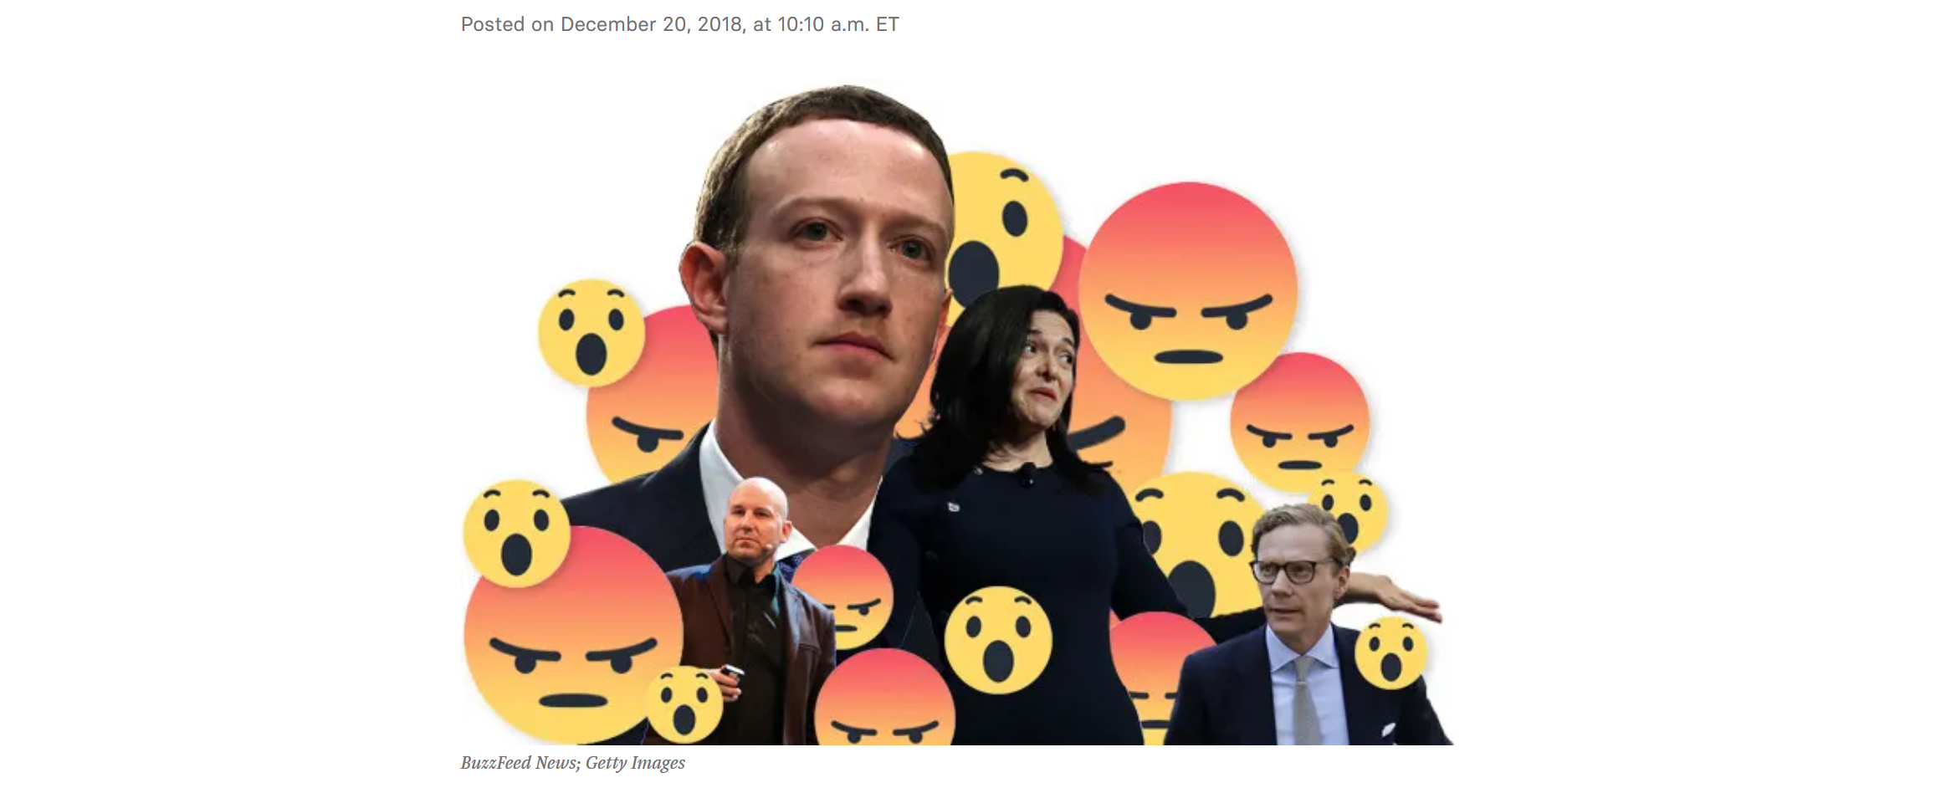

Slide 3
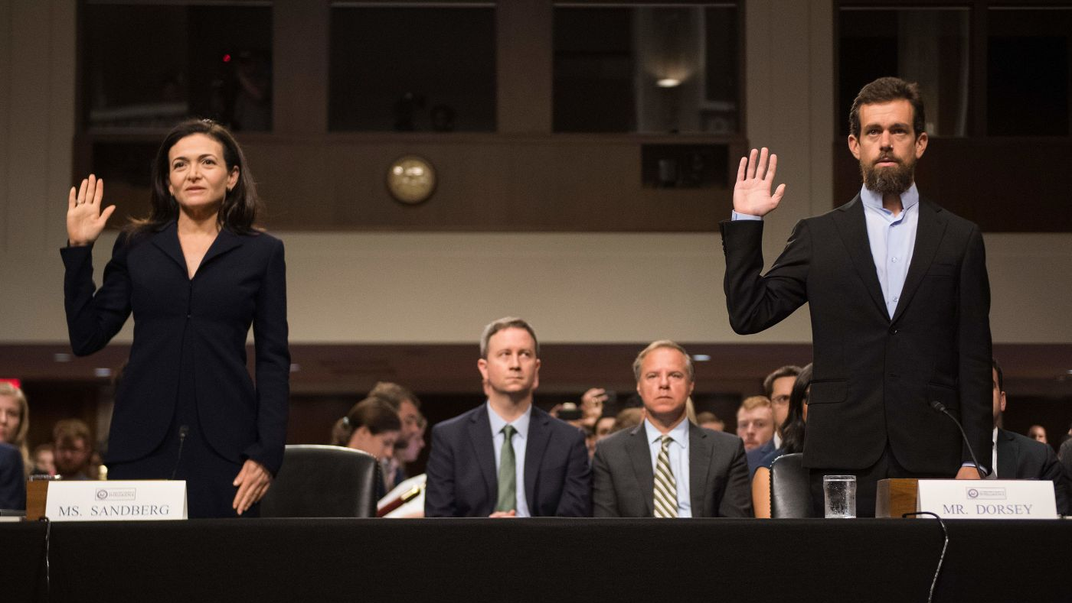
Trending news team did not promote news from conservative outlets
“Shadow banned” conservative accounts
Actually banned prominent “conservatives” like Alex Jones

Slide 4
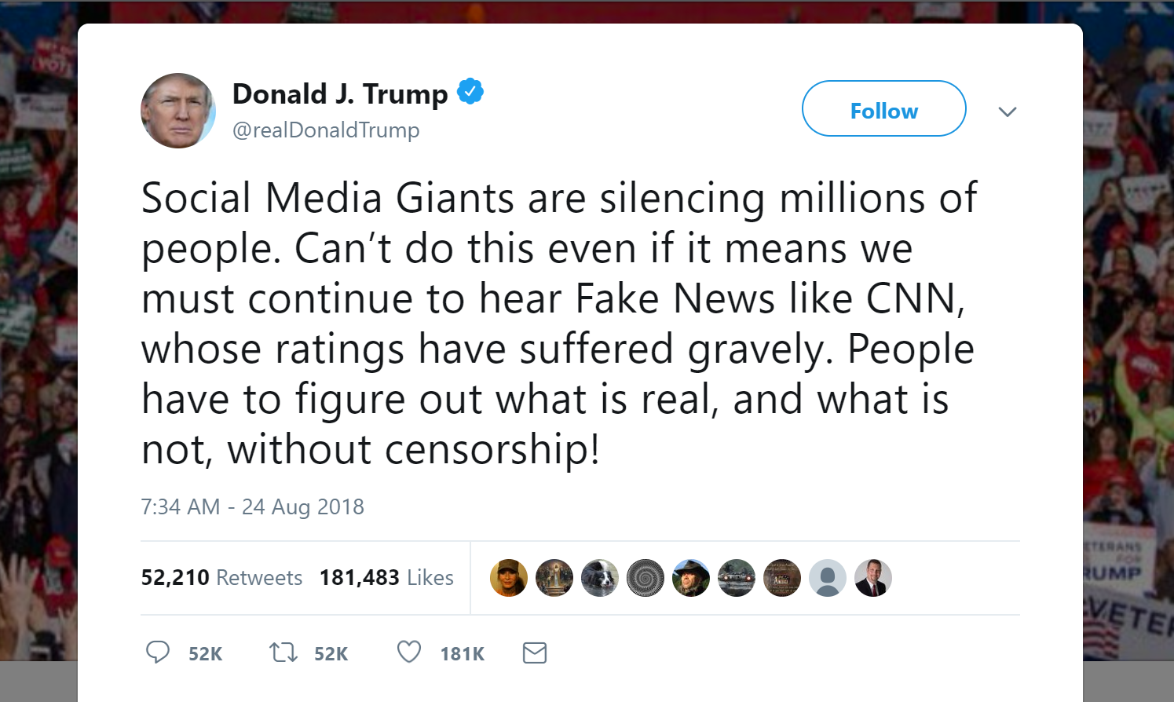

Slide 5
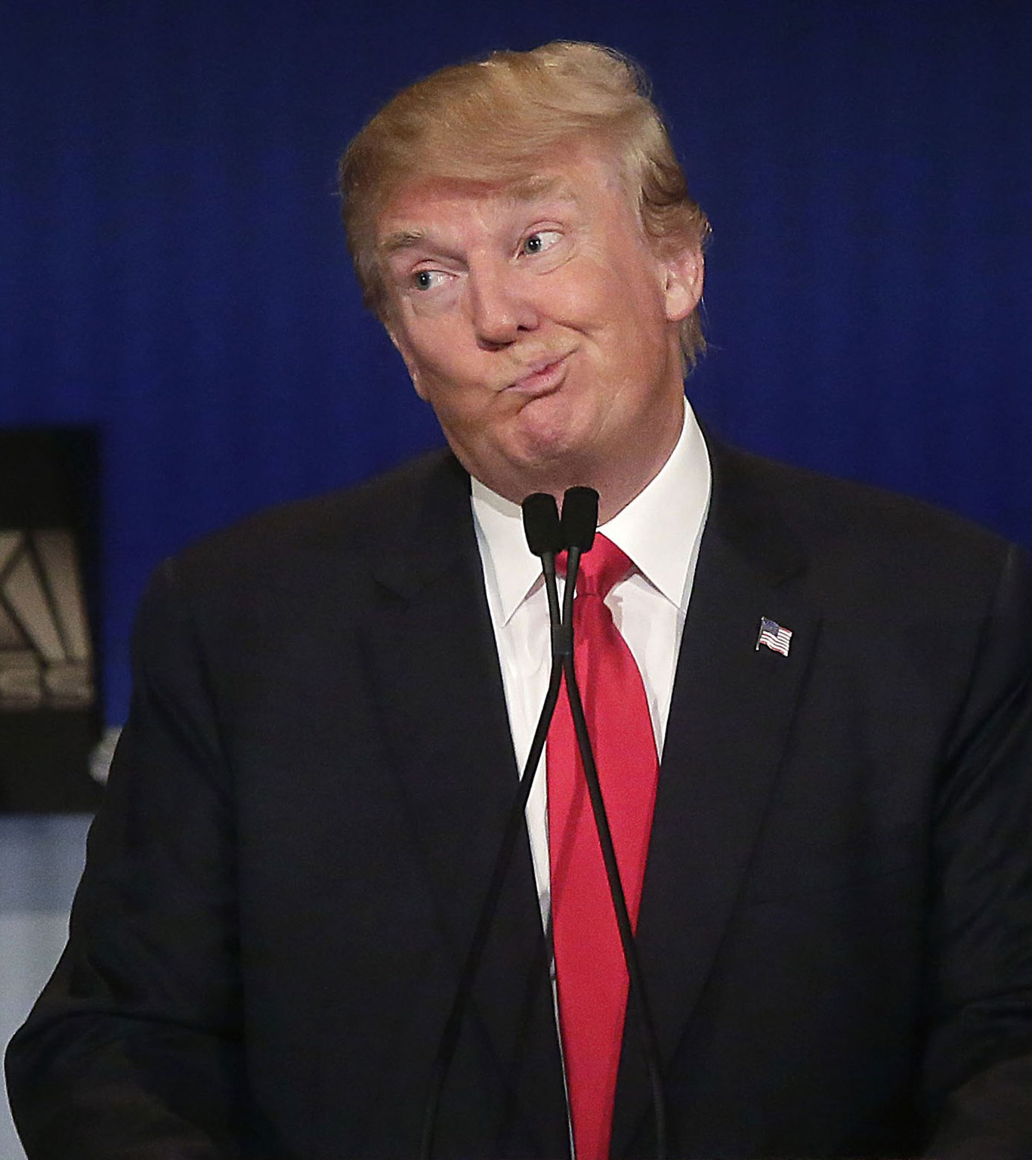
RQ: IS Donald Trump Right?

Slide 6
Actual Research Questions
Use YouTube as a lens to understand whether moderation of comments is politically biased
Four hypotheses – is comment moderation related to:
Direction of partisanship (left – right)
Magnitude of partisanship (extreme – center)
Veracity of video (true – false)
Posted before or after the video is fact-checked
Null hypothesis: the given variable is not correlated with comment moderation
Examine the RQs using two models:
Correlational
Causal (Propensity Matched)

Slide 7
Introduction DataSet Correlational Model Causal Model Conclusion

Slide 8
Data Needs
A pile of YouTube videos and their associated comments
Videos need to be labeled with partisanship, extremity, and veracity
Need two snapshots of the comments, separated in time
Comments that disappear were moderated
Need to model the linguistics of comments
Identify hate speech, harassment, and other types of speech that are against YouTube’s Community Guidelines

Slide 9
Data Collection Process
Crawled Snopes and Politifact, identified all fact checks of YouTube videos
2,000 videos with 828,000 comments
True/false veracity of each video
Determine which comments were posted before/after the fact check article was released

Slide 10
Data Collection Process
Crawled Snopes and Politifact, identified all fact-checks of YouTube videos
Used Google Search to link YouTube channels to domain names
RedStateMedia channel on YouTube → http://redstate.com
There are good datasets that score the partisanship of domains, but not YouTube channels
Used partisanship scores from Robertson et al. CSCW 2018
258 videos from 91 channels, 84,068 comments

Slide 11
Data Collection Process
Crawled Snopes and Politifact, identified all fact-checks of YouTube videos
Used Google to link YouTube channels to domain names
Deriving linguistic controls
Use a lexicon-based approach to label words in comments
Used ComLex from Jiang et al. CSCW 2018 and LIWC
Eight word categories that correlate with moderation
Swear words: profanity and racial slurs
Fake words: “lie”, “propaganda”, “bias”
Laughter: “lol”, “lmao”, “hahaha”
Emoji

Slide 12
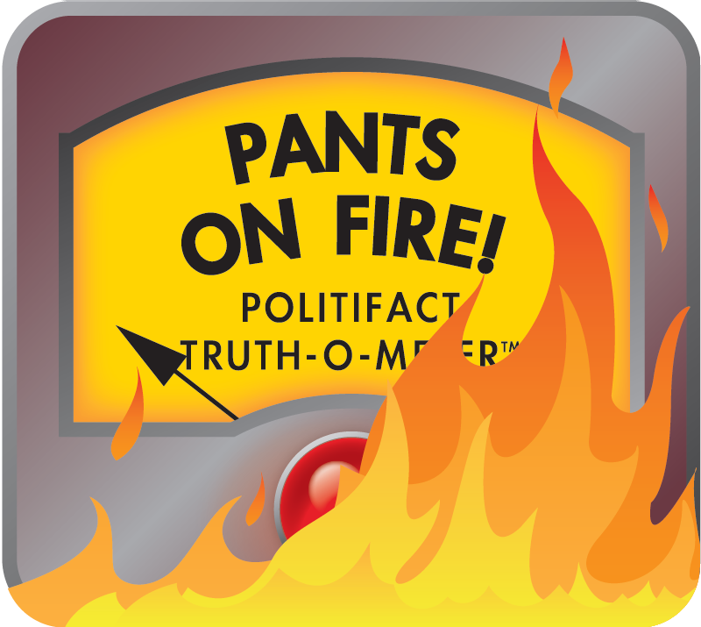

Final Dataset
258 YouTube videos from 91 channels, 84,068 comments
Crawled comments in January and June 2018
Missing comments were moderated
Likes, dislikes, views on each video
Veracity scores from Snopes/Politifact:
Assigned partisan scores to videos:
(-1) left → right (1)
|score| > 0.5 → extreme, else center

Slide 13
Introduction DataSet Correlational Model Causal Model Conclusion

Slide 14
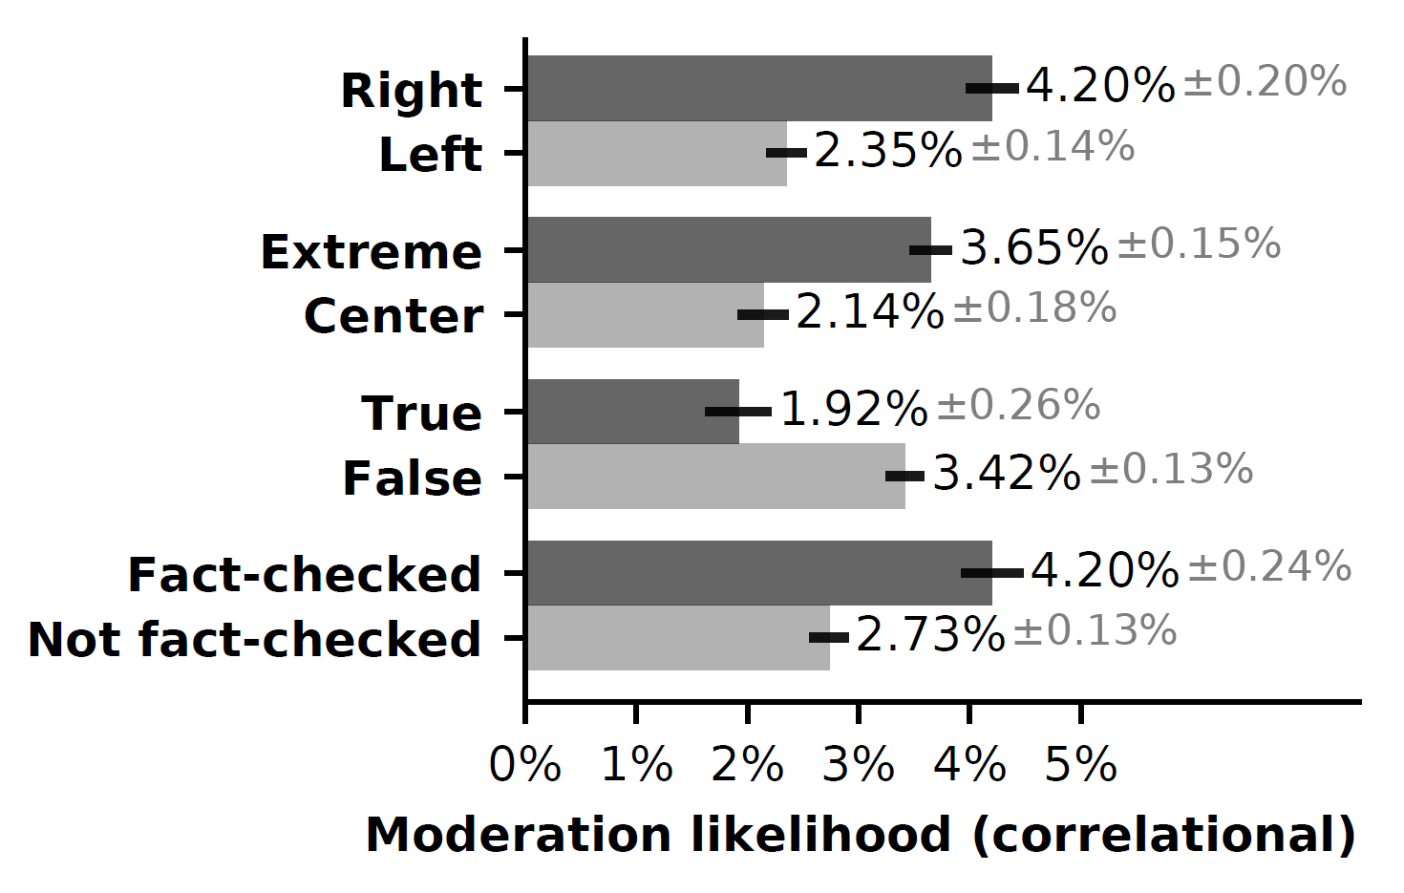
Being Conservative (Right-Leaning) Is Significantly Correlated with the Likelihood of Being Moderated
Moderation is 79% more likely for comments on right-leaning videos

Slide 15
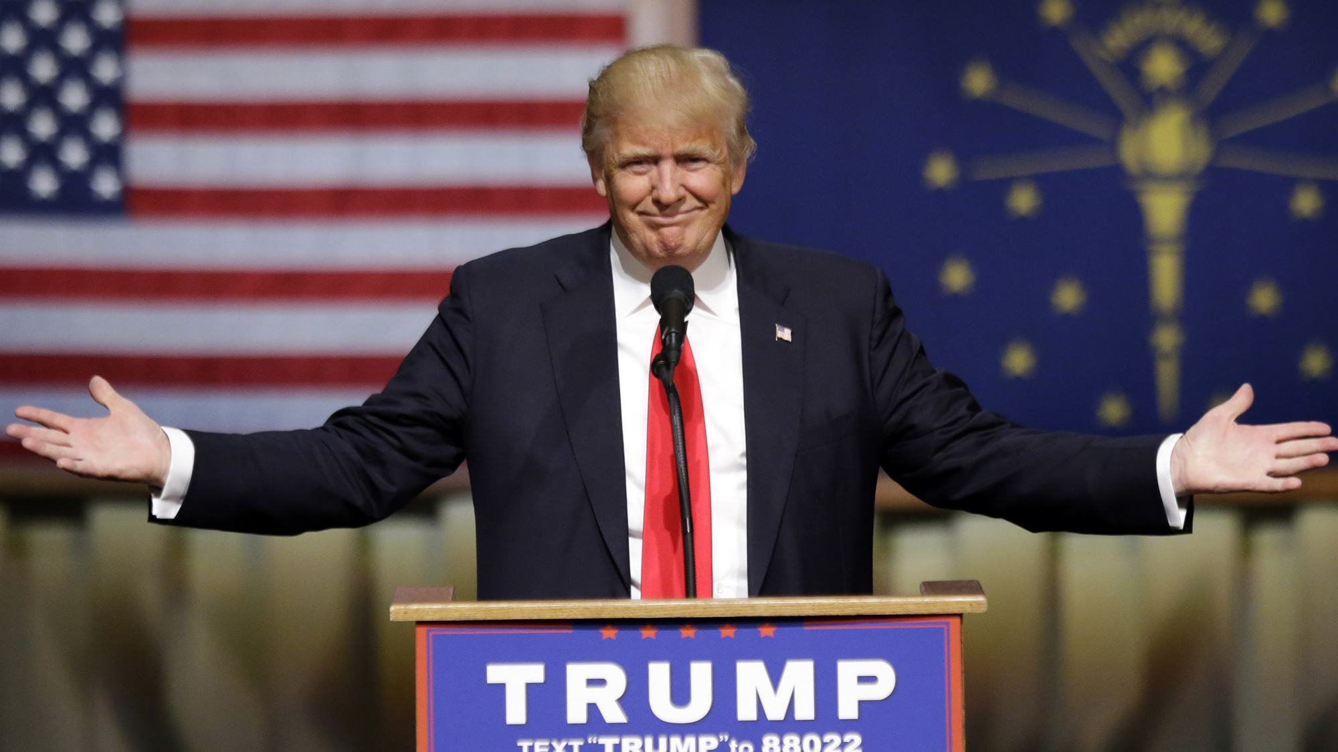

Slide 16
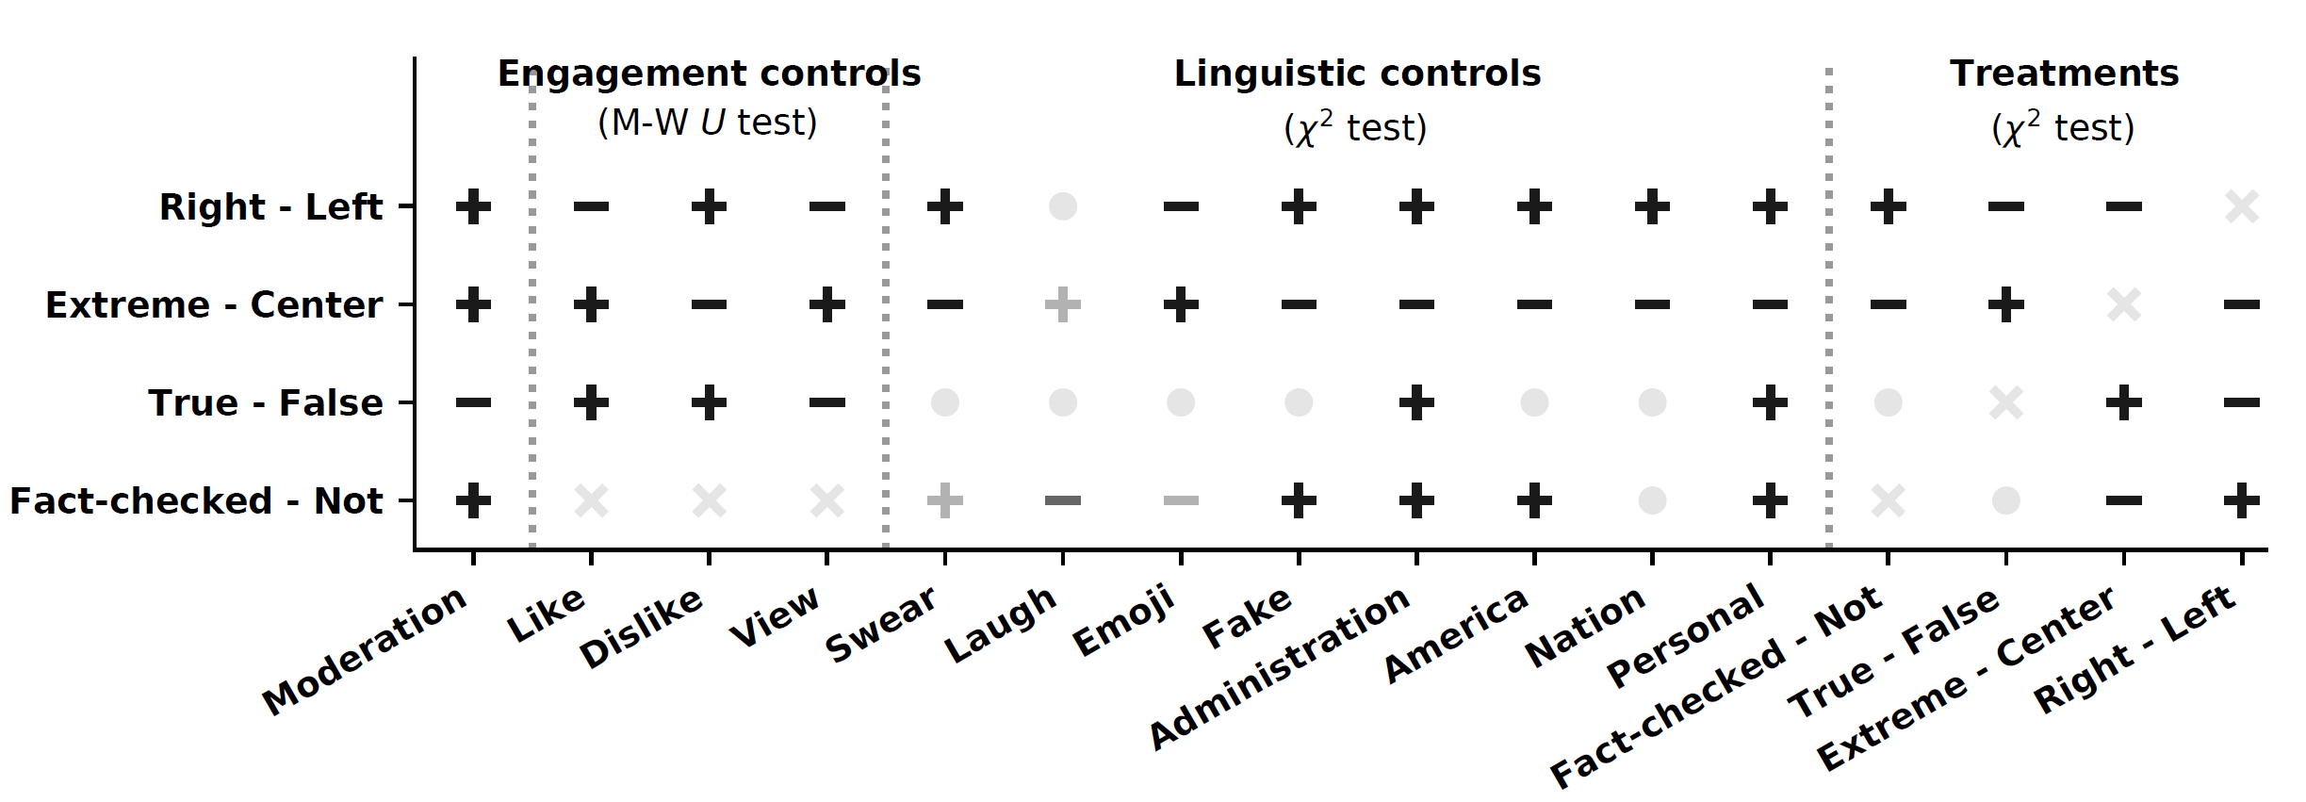
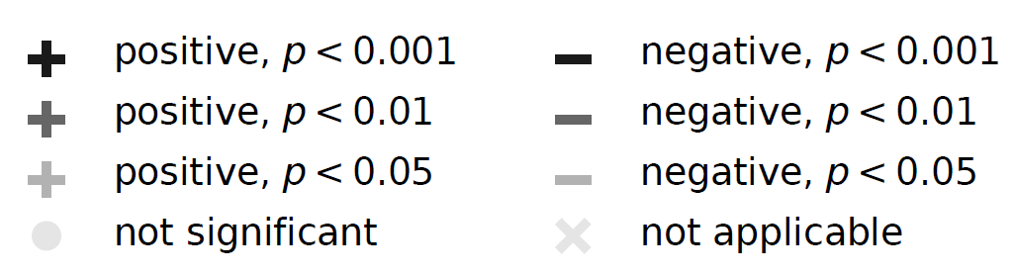
Problem: Everything is Correlated

Slide 17
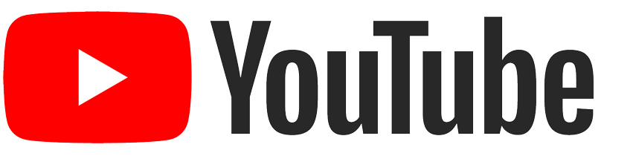
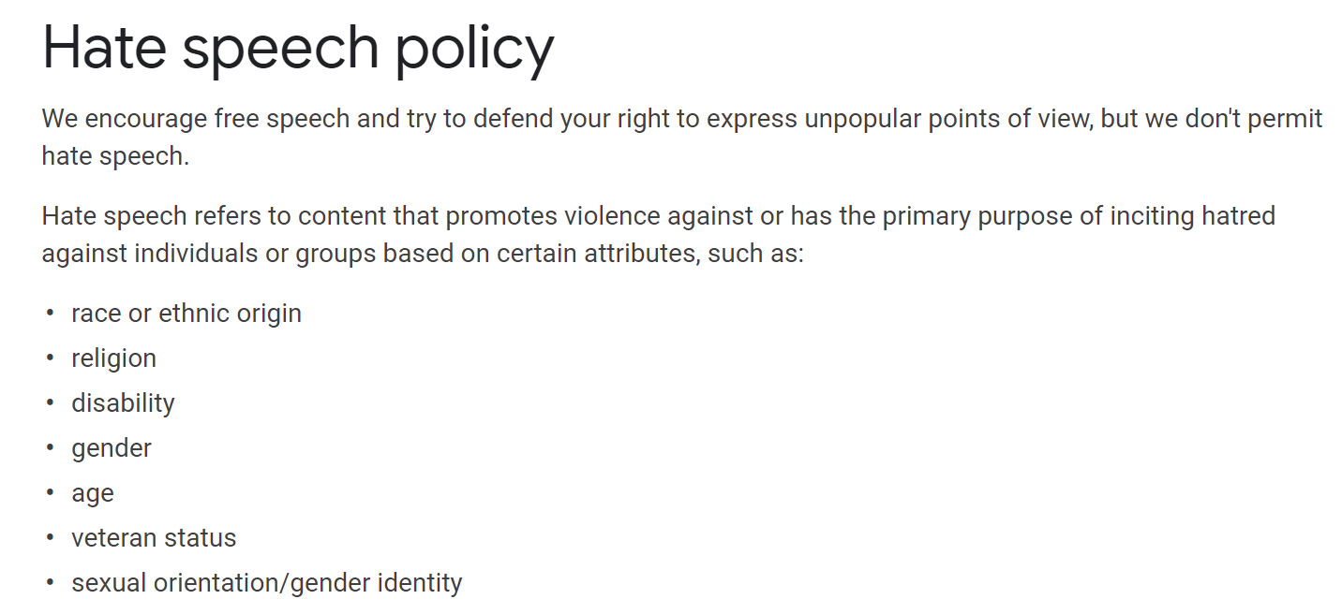

Slide 18
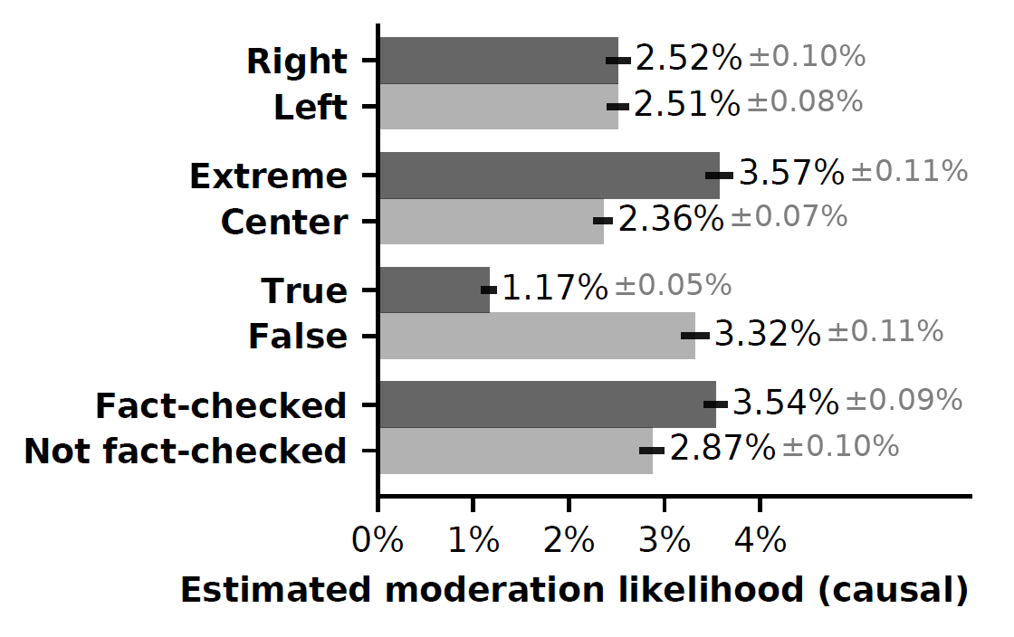
Propensity Matched Model
Controls for social engagements (likes, dislikes, etc.), linguistics (hate speech, etc.), and treatment effects
Hypothesis 1 is no longer rejected
Robust to changes in:
Lexicon
Right/left threshold
Extreme/center threshold
Fact-checker bias
Self-moderation rate

Slide 19
Introduction DataSet Correlational Model Causal Model Conclusion

Slide 20
Limitations
Unable to determine the cause of moderation
By the poster, by the channel/video operator, by YouTube itself
Video dataset is not representative
All videos were popular enough to be fact checked
Unmeasured confounds
User generated “flags” and “reports” on comments on videos

Slide 21
Conclusion
YouTube’s comment moderation system is not biased against political conservatives
Rather, YouTube appears to be enforcing its Community Guidelines
Moderation and right-leaning videos are correlated with extreme partisanship and misinformation
Comments on right-leaning videos are more likely to contain abusive language and hate speech
Our results help explain why there is a perception of bias against conservatives
Moderation decisions should be more transparent
Provide detailed feedback to affected users about why their content was moderated
Leave anonymized versions of moderated content online to help educate others

Slide 22
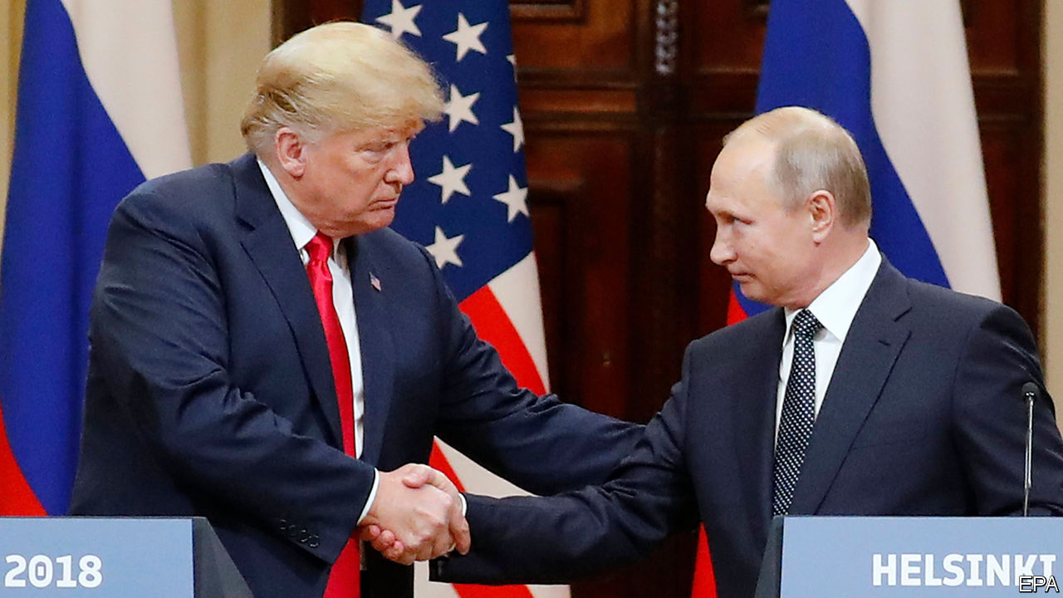
I am a very stable genius.
Next time, just p-hack it.
The End

Slide 23
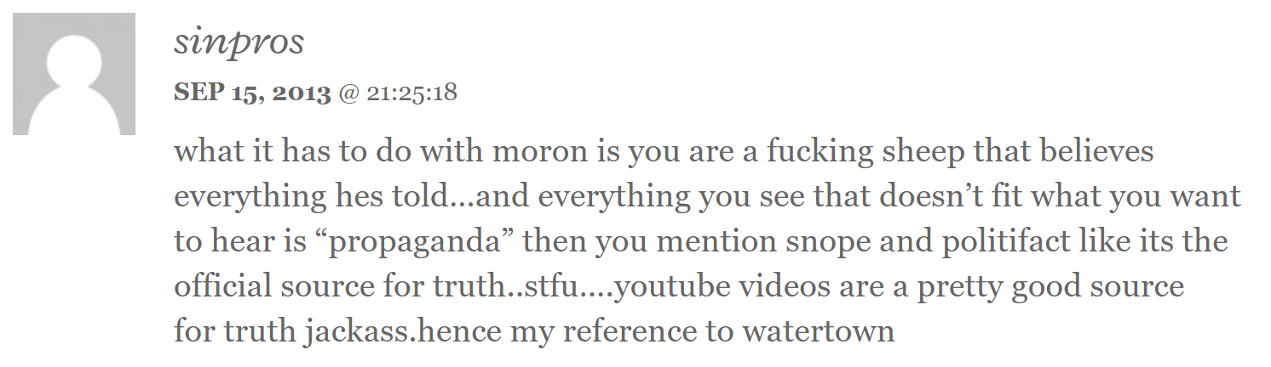
Exhibit A

